Slide 1
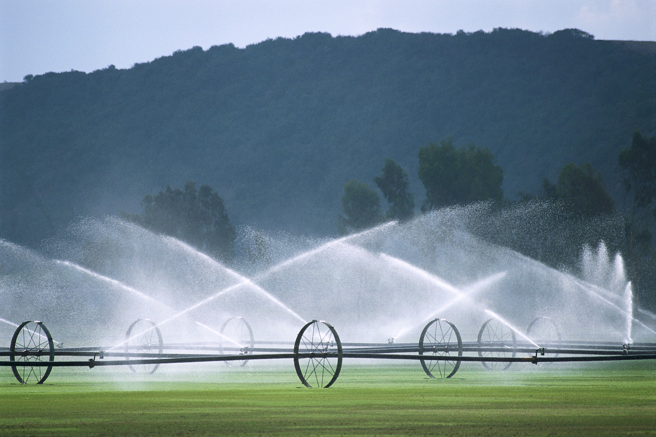
Division of Water Rights
WaterRights.utah.gov

Slide 2
Proof of Beneficial Use of Water Training for Licensed Engineers and Surveyors
Frank Quintana, PE
Tuesday, November 12, 2013

Slide 3

What do I show on a proof?

Slide 4
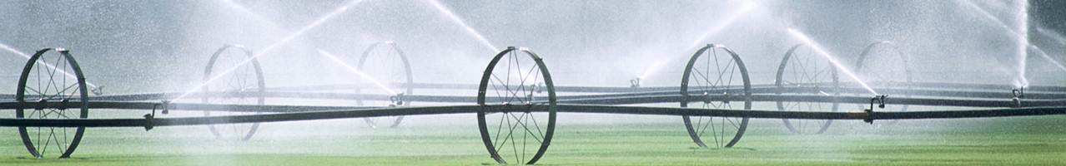
Information
Example
Municipal proof

Slide 5
Information

Slide 6
Proof means evidence of PRESENT and ACTUAL use of water
It doesn’t mean future or proposed use(s)

Slide 7
Order(s) of the State Engineer or Memorandum Decision(s)
Proof-due Date
Nature of Use
Place(s) of Use
Point(s) of Diversion
Period(s) of Use

Slide 8
Form

Slide 9
Affidavit of beneficial use of water (affidavit)
Prepared by the applicant
Applies only to “Small Amount of Water” applications
Optional

Slide 10
“Small Amount of Water” application limitations:
¼ acre
1 family
10 ELUs
ELUs = Equivalent Livestock Units

Slide 11
Proof of beneficial use of water (proof form)
Requires a professional to prepare it
Applies to all applications

Slide 12
R655-5-4.2.3
[…] the map must indicate the basis of bearing […].
R655-5-2.7.1
[…] place of beneficial use is the specific location (identified by a legal description by metes and bounds) of […] the area where water is placed to a recognized type of beneficial use. […].
R655-5-2.2
[…] based on measured ties (metes and bounds) to a regularly established and monumented section corner or quarter corner. […].
Rule R655-5
Maps Submitted to the Division of Water Rights

Slide 13
Water Right Example
Nature of Use 5 acres
2 families
20 ELUs
Reservoir or Pond
Quantity of Water
Point of Diversion
Place of Use
Period of use
Storage

Slide 14
Quantity of Water
Acreage X irrigation duty
# of families X diversion value
# of ELUs X diversion value
Inundated area X E-Lake value
Nature of Use
5 acres
2 families
20 ELUs
Reservoir or Pond (inundated area 4 acres)
Quantity of Water
20.00 acre-feet
0.90 acre-foot
0.56 acre-foot
7.72 acre-feet
29.18 acre-feet

Slide 15
Period of Use
November 1 to March 15
135 days
20 ELUs x 0.028 ac-ft/ELUs-yr
0.56 ac-ft/yr x 135/365
0.21 ac-ft/yr
Nature of Use
5 acres
2 families
20 ELUs
Reservoir or Pond (inundated area 4 acres)

Slide 16
Point of Diversion
Description of water source(s)
Description of diverting works
Surveyed location(s)
Measured flow(s)
Nature of Use
5 acres
2 families
20 ELUs
Reservoir or Pond (inundated area 4 acres)

Slide 17
Place of Use
Description in each 40-acre tract
Nature of Use
5 acres
2 families
20 ELUs
Reservoir or Pond (inundated area 4 acres)

Slide 18
Storage
Capacity (acre-feet)
Dam height (feet)
Inundated area (acre)
Description of inundated area in each 40-acre tract
Nature of Use
5 acres
2 families
20 ELUs
Reservoir or Pond (inundated area 4 acres)

Slide 19
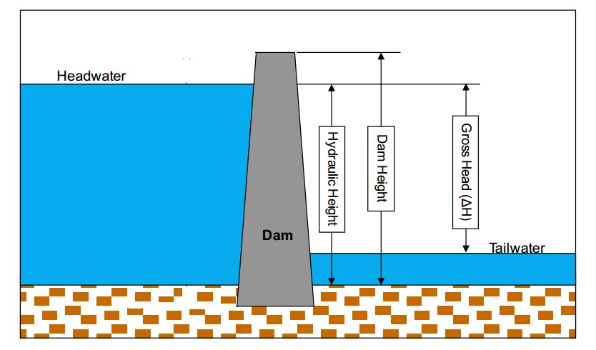

Slide 20
Options

Slide 21
Water Right Example
(Proposed)
Nature of use
5 acre
2 families
20 ELUs
(Actual)
Nature of use
5 acre
2 families
20 ELUs

Slide 22
Water Right Example
(Proposed)
Nature of use
5 acre
2 families
20 ELUs
(Actual)
Nature of use
3 acre
2 families
10 ELUs

Slide 23
Options available:
Submit proof
File an extension request
Segregate the undeveloped portion
File proof on developed portion
File an extension on undeveloped portion

Slide 24
Municipal Proof

Slide 25
What to review before preparing a MUNICIPAL proof?

Slide 26
Within the service area of + name of municipality
Perfected and Unperfected
No map required
Water use data
Municipal

Slide 27
1 CFS = 723.97 acre-feet/year

Slide 28
Step No. 1
Review “Water Use Data”
Year | Amount Reported (acre-feet)
2013 | 29 000
2012 | 27 000
2011 | 30 000
2010 | 28 000
2009 | 26 000
Highest amount reported: 30 000 acre-feet (2011)

Slide 29
Step No. 2
Categorize “Perfected and unperfected” water rights
(Scenario One)
Perfected |  | Unperfected
Water Right Number | Quantity of Water (acre-feet) | Water Right Number | Quantity of Water (acre-feet)
22-2221 | 15 000 | 22-2224 | 20 000
22-2222 | 5 000 | 22-2225 | 10 000
22-2223 | 10 000 | 22-2226 | 15 000
TOTAL | 30 000 | TOTAL | 45 000

Slide 30
Step No. 2
Categorize “Perfected and unperfected” water rights
(Scenario Two)
Perfected |  | Unperfected
Water Right Number | Quantity of Water (acre-feet) | Water Right Number | Quantity of Water (acre-feet)
22-2221 | 15 000 | 22-2224 | 20 000
22-2222 | 5 000 | 22-2225 | 10 000
22-2223 | 5 000 | 22-2226 | 15 000
TOTAL | 25 000 | TOTAL | 45 000

Slide 31
Step No. 3
If amount reported > amount perfected, a proof can be submitted for up to the difference

Slide 32
SUMMARY
PROOF form (and affidavit)
Proof is evidence of PRESENT and ACTUAL use of water
Nature of Use

Slide 33
SUMMARY
4. Options available when proof is due:
Submit proof
Request an extension of time
File a segregation request to separate any future development, then:
File proof on developed portion
File extension request on undeveloped portion

Slide 34
SUMMARY
5. Before preparing a MUNICIPAL proof:
Review the “Water User Data” reported to the “Water Use Program” of the Division of Water Rights
Do an accounting of the perfected and unperfected water rights of the municipality
If amount reported is greater than amount perfected, a proof can be submitted for up to the difference between the two amounts

